Slide 1
The JUDICIAL BRANCH The Court System in the United States

Slide 2
Creation of a National Judiciary
Article III, §1, of the Constitution provides that "[t]he judicial Power of the United States, shall be vested in one supreme Court, and in such inferior Courts as the Congress may from time to time ordain and establish." The Supreme Court of the United States was created in accordance with this provision and by authority of the Judiciary Act of September 24, 1789 (1 Stat. 73). It was organized on February 2, 1790.
Source: http://www.supremecourt.gov/about/briefoverview.aspx

Slide 3
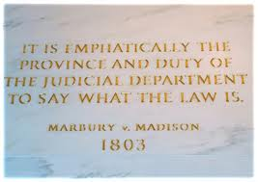
Judicial Review
Judicial Review is the power to interpret laws, to determine their meaning, and to settle disputes within the society.
The power of Judicial Review was established by the Supreme Court with Marbury v. Madison.
It makes the Supreme Court the final authority on the meaning of the Constitution.

Slide 4
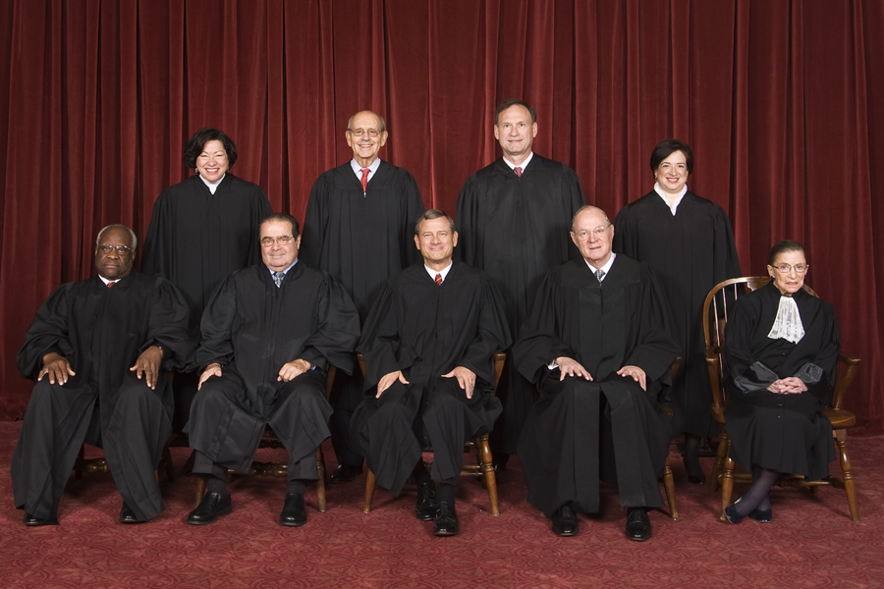
The Supreme Court
http://www.supremecourt.gov/about/briefoverview.aspx

Slide 5
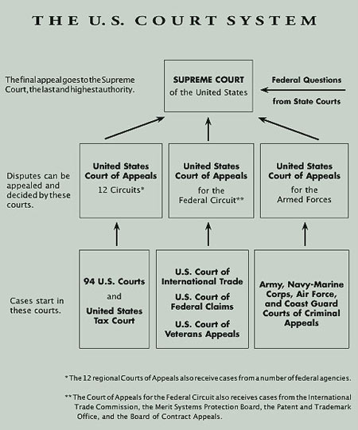
The Federal Court System

Slide 6
Florida Court System

Slide 7
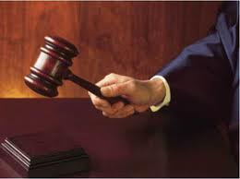
Types of Courts
A. Constitutional courts – Supreme Court, Courts of Appeals, the District Courts and the Court of International Trade
B. Legislative courts – Congressional courts
C. Civil/Criminal courts
D. Original jurisdiction
E. Appellate jurisdiction

Slide 8
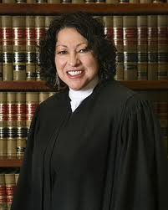
Selection of Federal Judges
Senatorial Courtesy and Judicial Appointments:
A. Senate Judiciary Committee
B. race, party, sex
C. ideology
D. judicial activism/judicial restraint
E. longevity, tenure

Slide 9
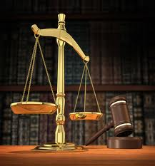
Types of Law
A Statutory law – law enacted by legislative body
B. Common law – based on custom or court decision
C. Constitutional law
D. Administrative law- quasi judicial
E. Criminal Law – plea bargains, public defenders,
voluntary defenders, pro bono
F. Civil Law – laws related to
ordinary, private matters

Slide 10
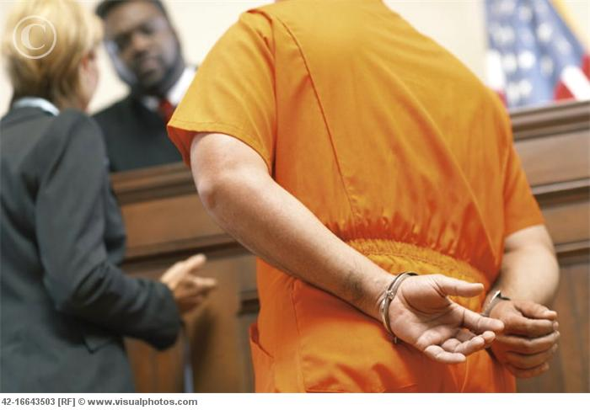
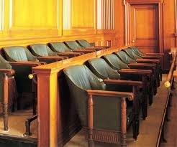
Parties to Suits
Plaintiff
Defendant
Appellant
Appellee
Types of Juries
Grand Jury – Indictment
Petit Jury – decides guilt or innocence

Slide 11
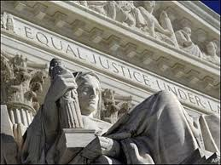
Appeal Procedure
Petition of certiorari, request for Supreme Court review (approximately 10,000 requests)
Discuss the list in conference, review denied in 98% of all requests
Rule of four puts a case on the docket (approximately 100 cases per year)
Preparation of briefs
Oral argument
Conference
Opinion – majority, minority, dissenting, concurring

Slide 12
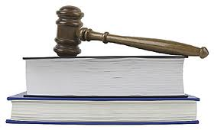
Landmark Supreme Court Cases
Brown v. Topeka Board of Education
Engle v. Vitale
Escobedo v. Illinois
Gideon v. Wainwright
Mapp v. Ohio
Miranda v. Arizona
Regents of the University of California v. Bakke
Roe v. Wade
Webster v. Reproductive Health Services
Tinker v. DesMoines
Miller v. California

